Slide 1

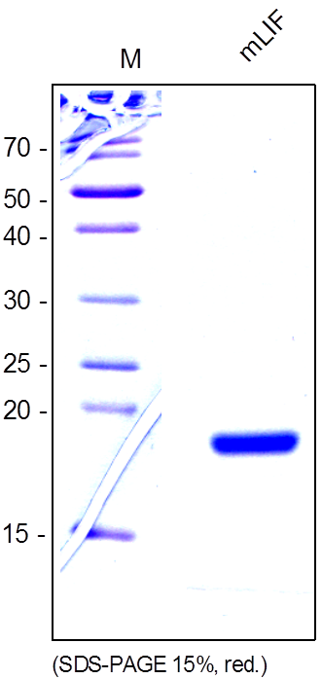
ReliaTech GmbH
Recombinant human Leukemia Inhibitory Factor (LIF)
(Cat #M30-007 / M30-008)
Fig. 1: SDS-PAGE analysis of recombinant mouse LIF produced in E. coli. Sample was loaded in 15% SDS-polyacrylamide gel under reducing conditions and stained with Coomassie stain.
http://www.reliatech.de / orders@reliatech.de

